Slide 1
Invest Easy Webpage
https://www.aia.com.sg/en/our-products/investments/aia-invest-easy.html
Please create vanity link: aia.com.sg/investeasy

Slide 2
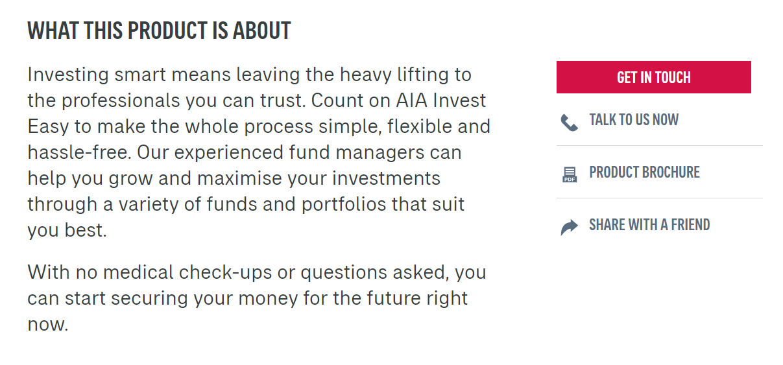


We will provide updated PDF
AIA Global Dynamic Income Fund Flyer
Add this, we will provide PDF

Slide 3
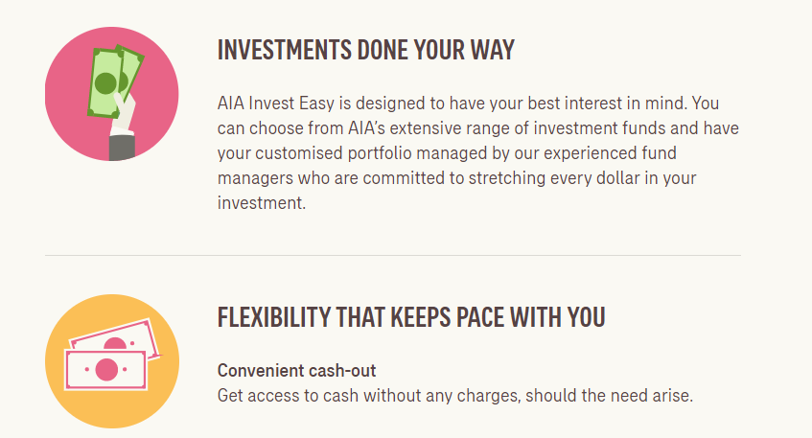
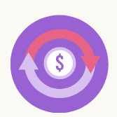
Regular income stream
Receive regular income via dividend distribution when you invest in a dividend-paying fund.^
ADD NEW FEATURE

Slide 4
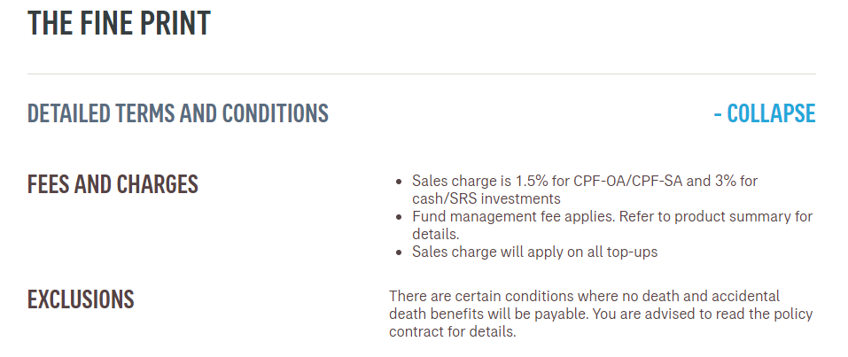
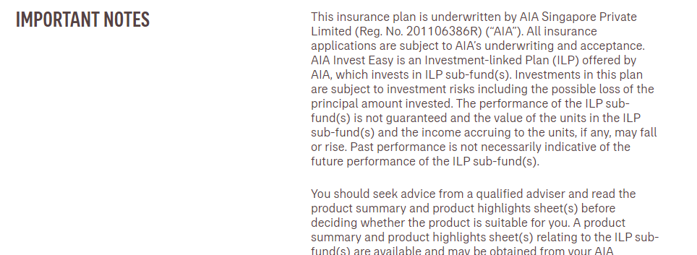
We may declare dividends for certain ILP Sub-Funds that include the option for you to accept dividend payments. The amount of the dividends payable will be based on the number of units held by you in that fund on ex-date, as evidenced in our records. Dividends are not guaranteed.
The frequency of dividend distribution of an ILP Sub-Fund is not guaranteed and determined by us at our sole discretion. By default, the dividends will be reinvested and distributed as additional units in the fund, equivalent to the total value of the dividends divided by the bid price of each unit prevailing on the reinvestment date.
For certain ILP Sub-Funds, there will be two business days of non-dealing during which the subscription and/or redemption of units cannot be carried out (including transactions such as fulfilling single premium payments, top-up premium requests, fund switch requests, partial withdrawal/ full surrender/ claim requests or your exercise of the free-look option which necessarily lead to the subscription or redemption of units). The non-dealing days will occur before an ex-date. All the subscription and/or redemption of units shall be transacted based on the prevailing bid price as at the valuation day after the non-dealing days.
Investors should take note of the risks associated with dividend distribution.
Dividends from the underlying fund(s) may be adversely affected by (amongst others) investee entities suffering unexpected losses and/or paying lower than expected dividends.
AIA Singapore intends to distribute dividends from the income and/or net realised gains of the ILP Sub-Fund, and AIA Singapore maintains the discretion to distribute dividends out of capital. Where dividend distributions are made out of capital, it may lead to a reduction in investor’s original investment and may also result in reduced future returns to the investor.
Both capital and dividend distributions are not guaranteed.
Please refer to the AIA Investment Fund Product Summary and Product Highlight Sheet for further details on dividend distribution and risks associated with the ILP Sub-Fund.
DIVIDEND DISTRIBUTION
…as at 8 September 2020.

